Slide 1


Essex Watch and Neighbourhood Watch Transition Update
Chief Superintendent Waheed Khan
Head of Local Policing Support Unit
Date: 10th September 2025

Slide 2
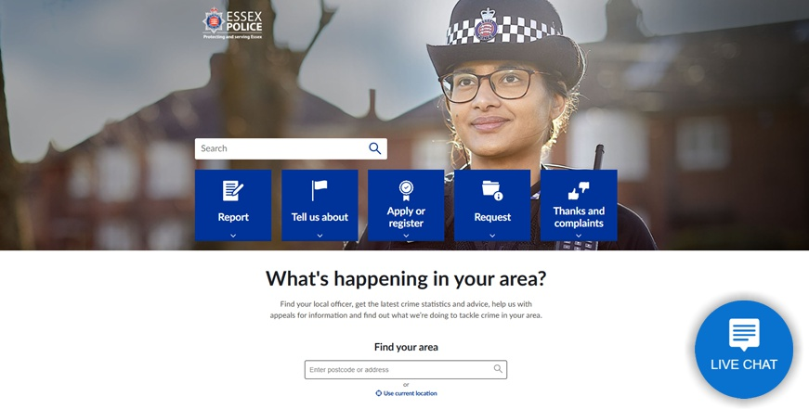
Essex Police website

Slide 3
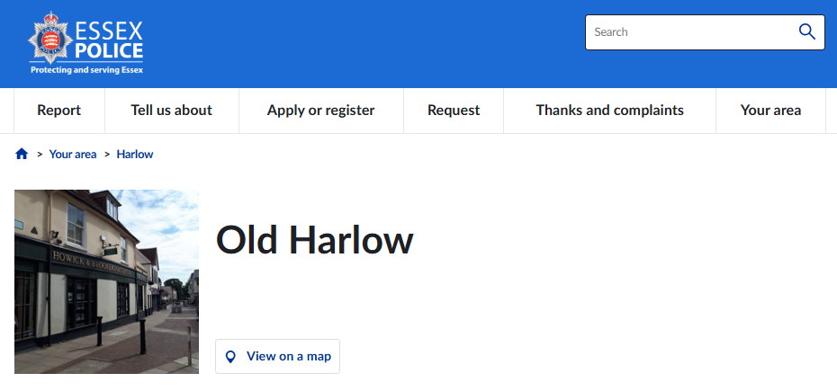
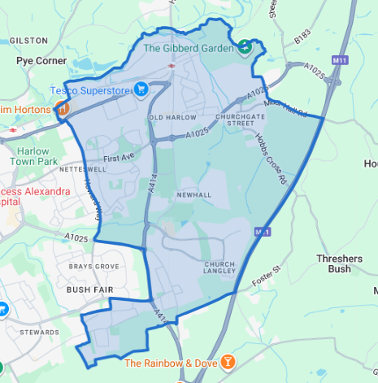
Essex Police website – Your Area

Slide 4
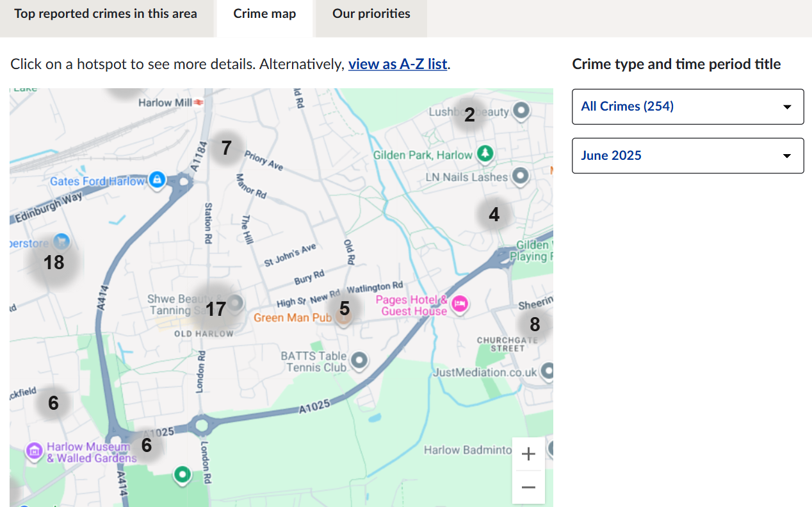
Essex Police website – Your Area

Slide 5


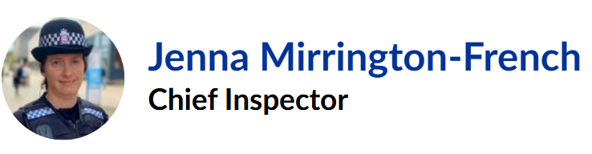
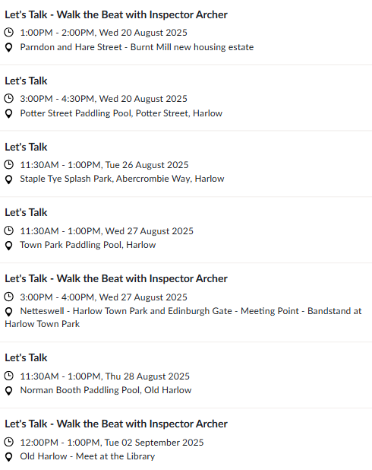
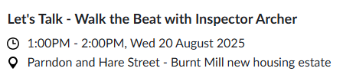
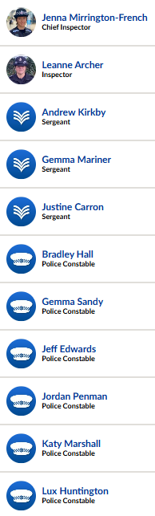
Essex Police website – Your Area

Slide 6
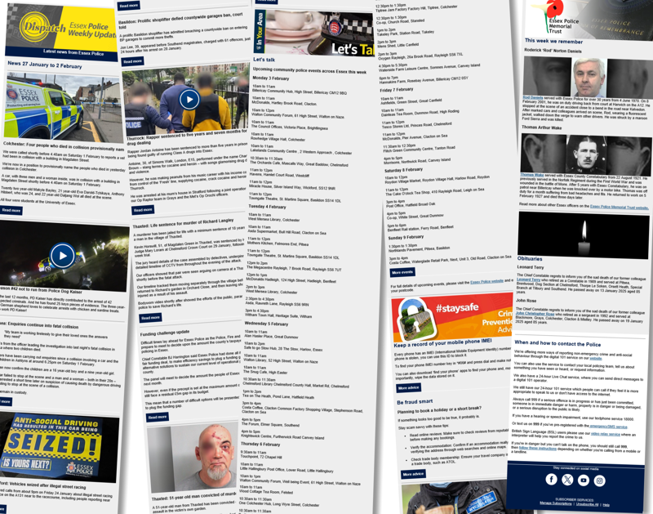

Dispatch weekly email newsletter

Slide 7
Dispatch weekly email newsletter
Weekly email newsletter sent to subscribing members of the public.
Monday edition covers the whole Essex area.
Wednesday edition covers 14 districts within Essex.
Managed by the Media and Communications Department.
District editions edited by Community Safety Engagement Officers.

Slide 8
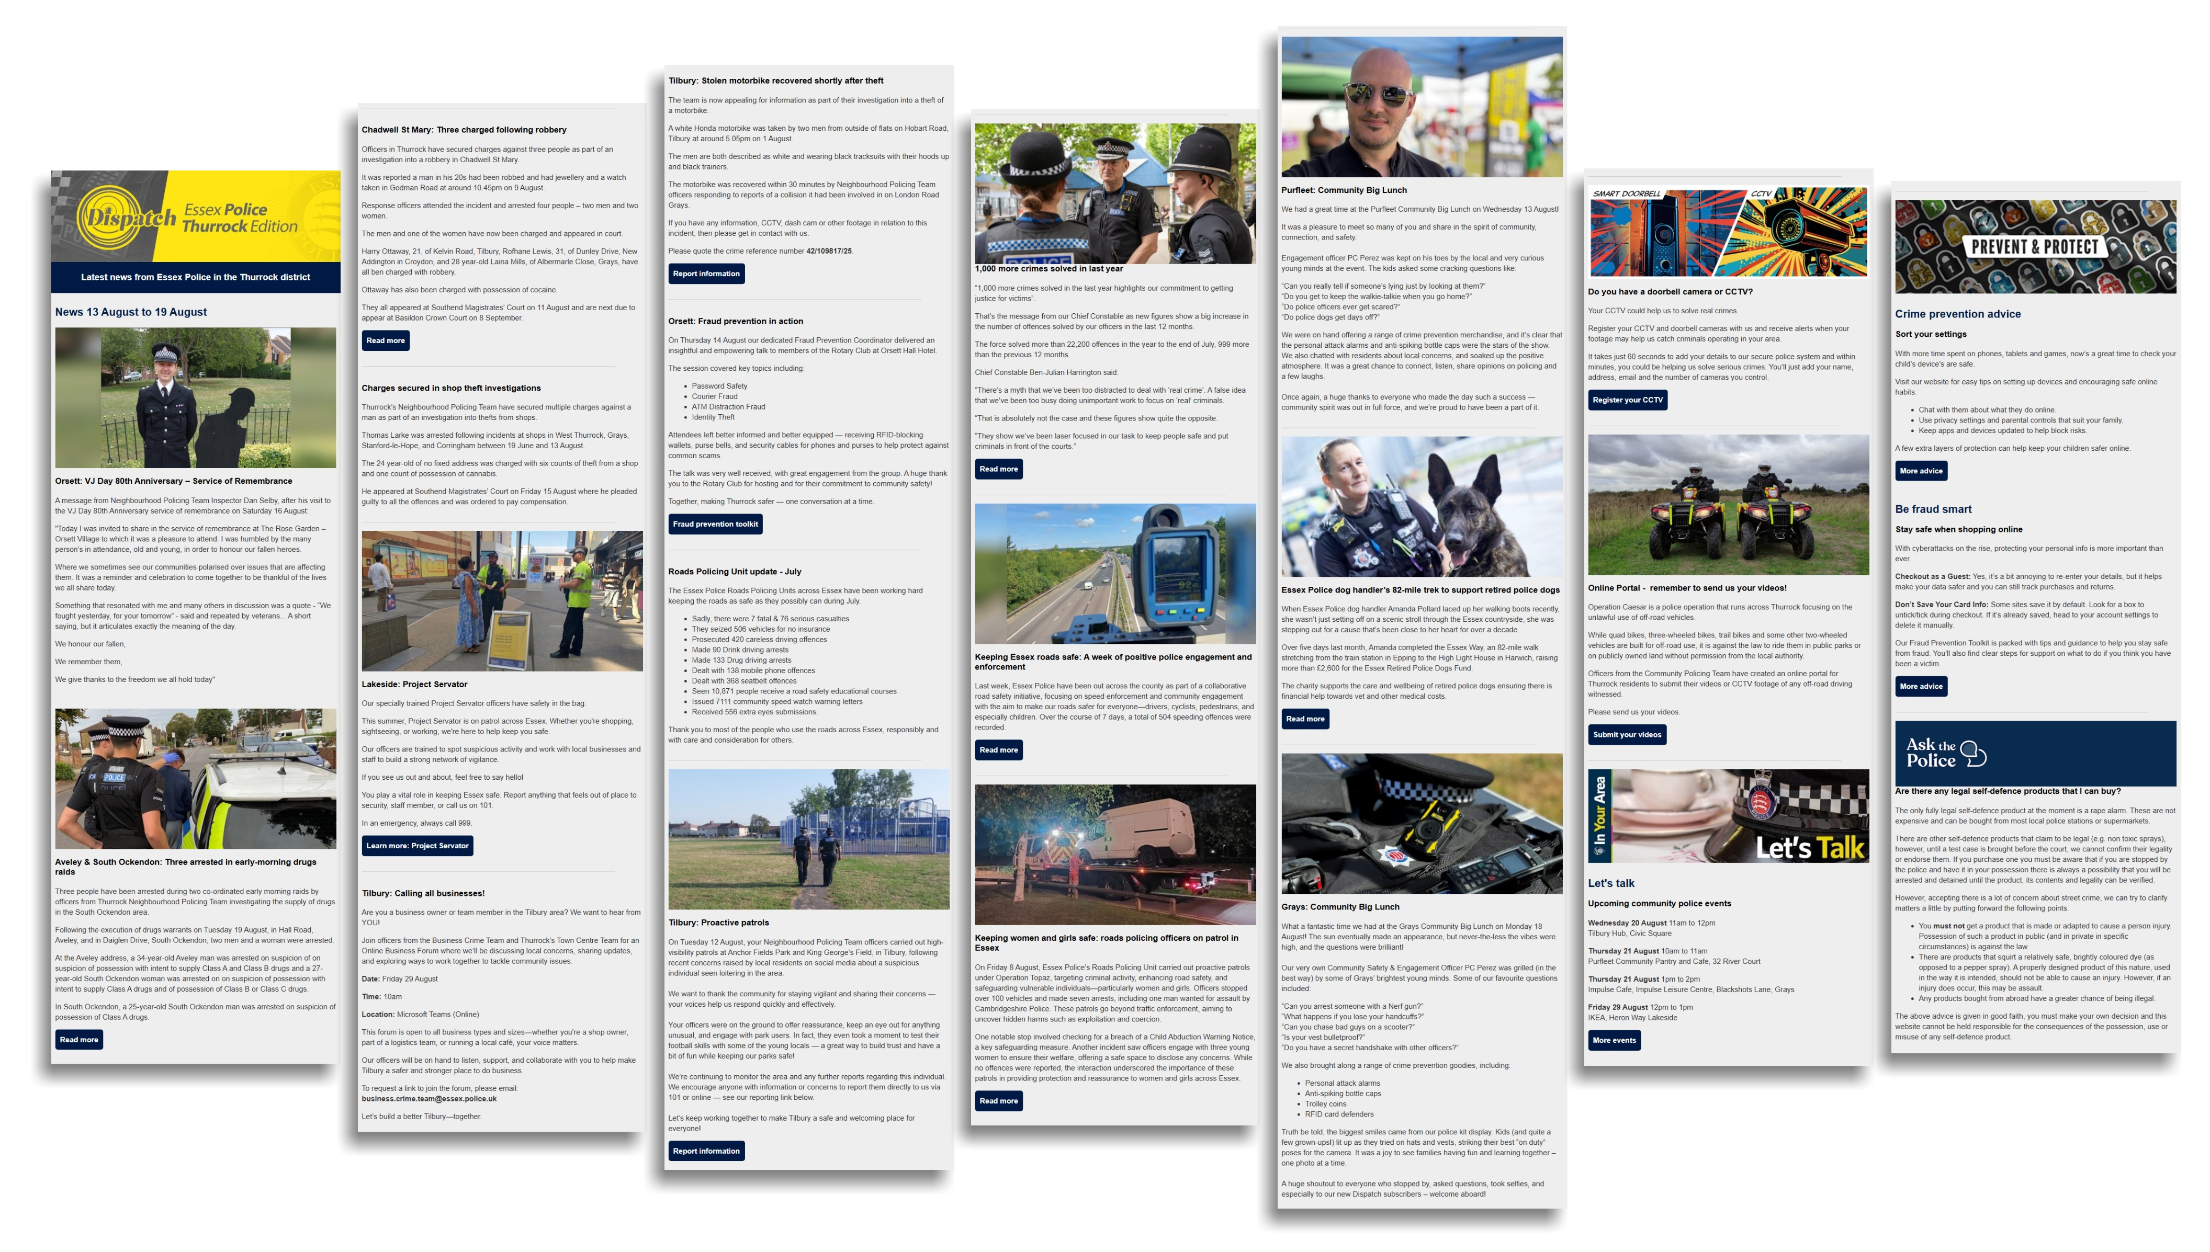
Dispatch weekly email newsletter

Slide 9
Dispatch weekly email newsletter
News about local policing from the last 7 days
Events and meetings
Crime prevention advice
Fraud prevention tips
Frequently Asked Question of the Week

Slide 10
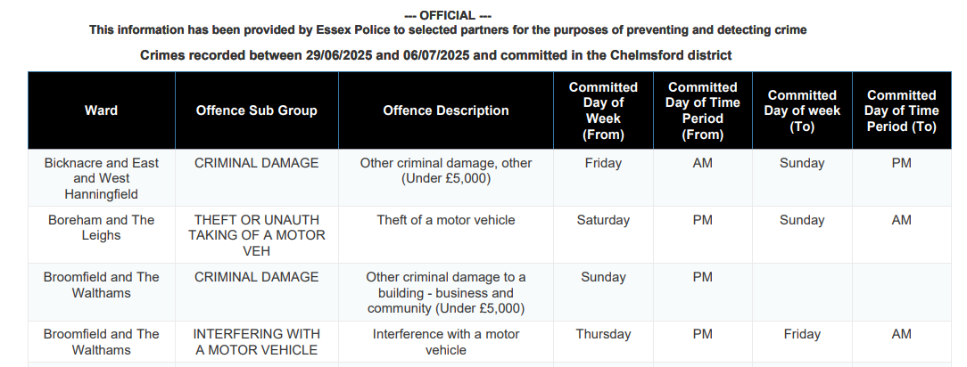
New Style Automated Crime Data
  Restricted by Data Protection rules
  Future development via AI
  Inclusion partial postcode

Slide 11
Ownership & Engagement
Neighbourhood Policing Inspectors and Teams – main contact for NHW, Allotment, Caravan and Dog Watch
Rural Engagement Team – Horse Volunteers, Farm and Heritage Watch
Marine Unit – Marine Watch
Business Crime Team – Business Watch

Slide 12

Transition from email distribution to website
Phasing out current emails containing PDFs
Phasing in website dashboards
Dispatch – weekly crime updates & crime data
Dashboards can be filtered by:
  District
  Location
  Offence
  Watch
Data exportable to spreadsheet format

Slide 13
Transition from email to website timescale
Emails & PDFs continue until 6 October
Dispatch and website only from 7 October
www.essex.police.uk/essexwatch
www.essex.police.uk/dispatch

Slide 14
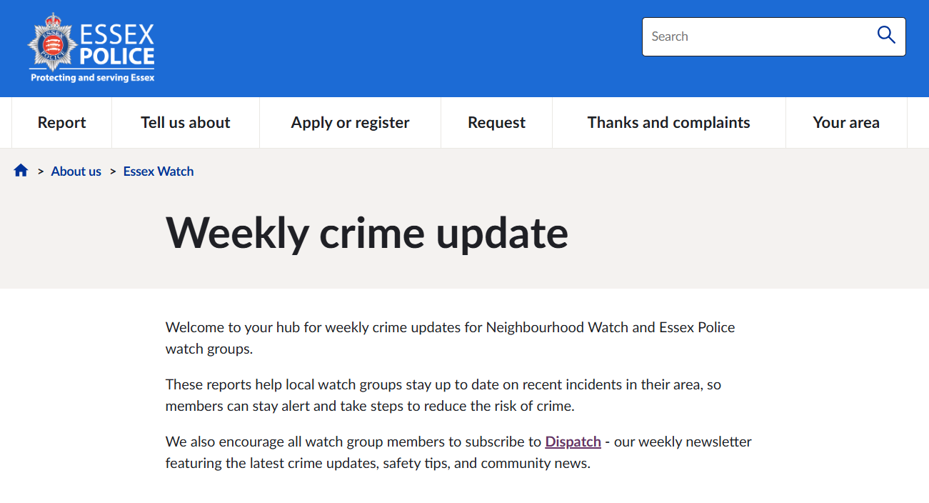

Slide 15
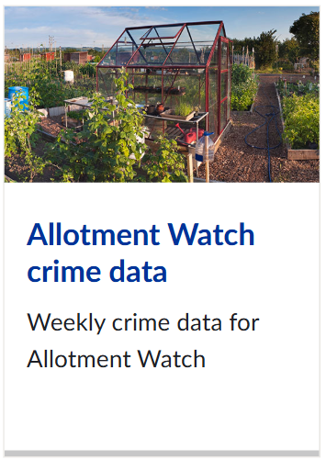

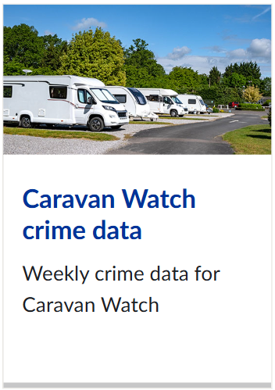
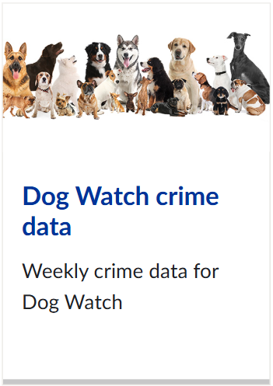


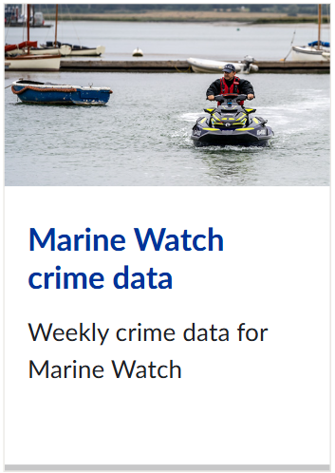


Slide 16
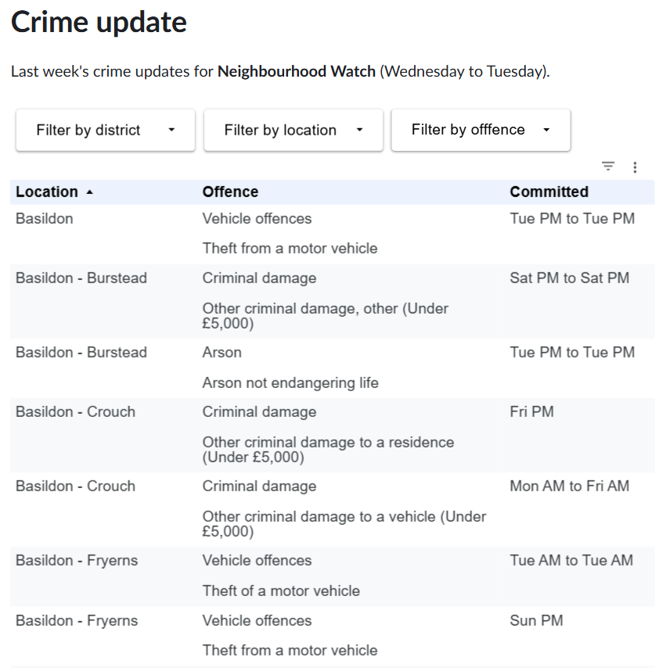

Slide 17
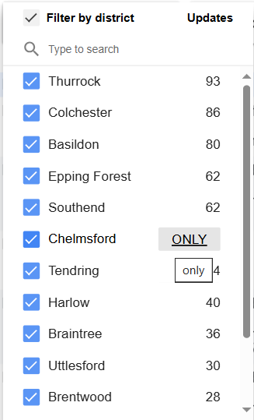
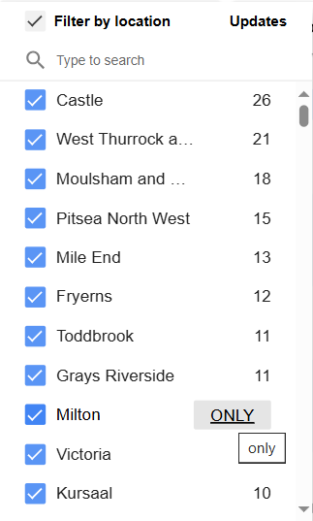
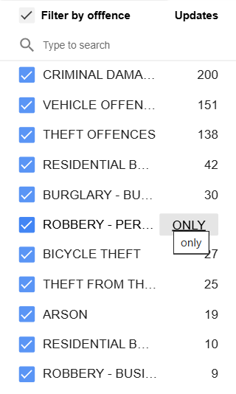

Slide 18
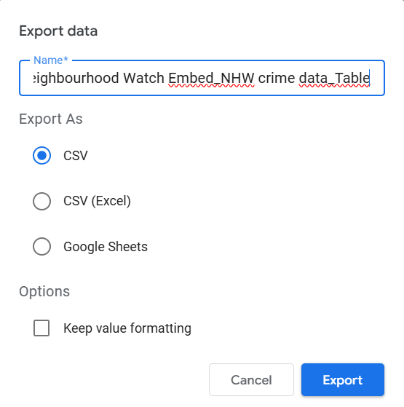

Slide 19
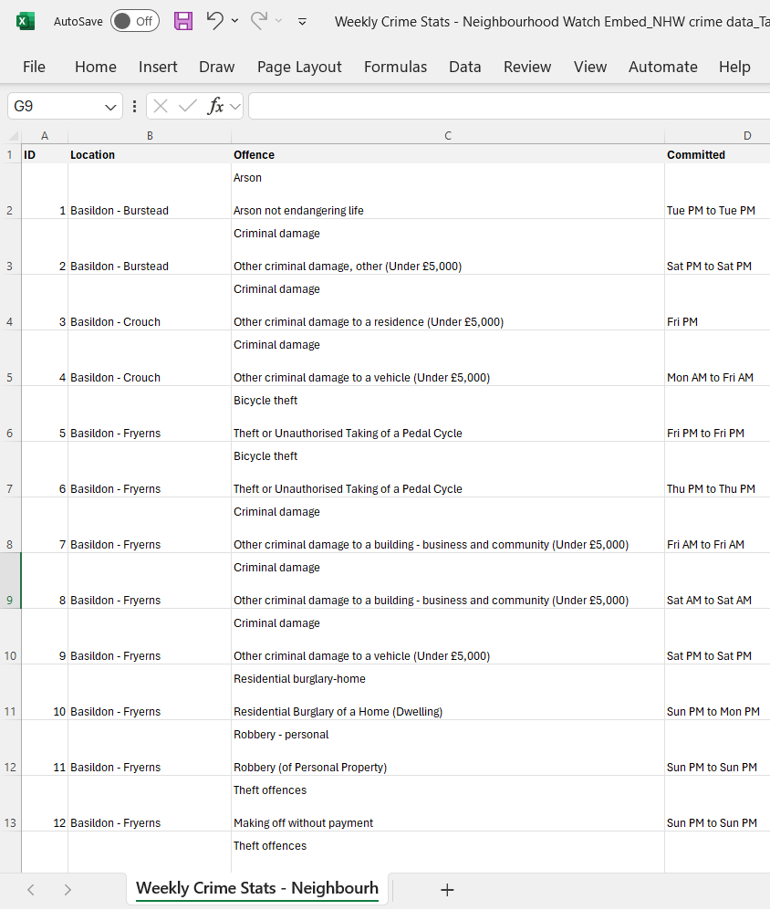

Slide 20

Summary
Good news – crime being solved – more local policing
Opportunities to engage with local policing teams directly
Access crime information and prevention advice via essex.police.uk and Dispatch
Next steps – increased technology, better use of Dispatch

